Slide 1

12/2 Report
By Bolun

Slide 2
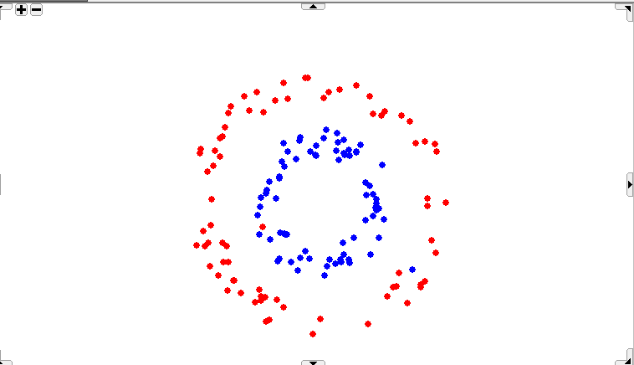
How the choice of epsilon is affecting the results?

Slide 3
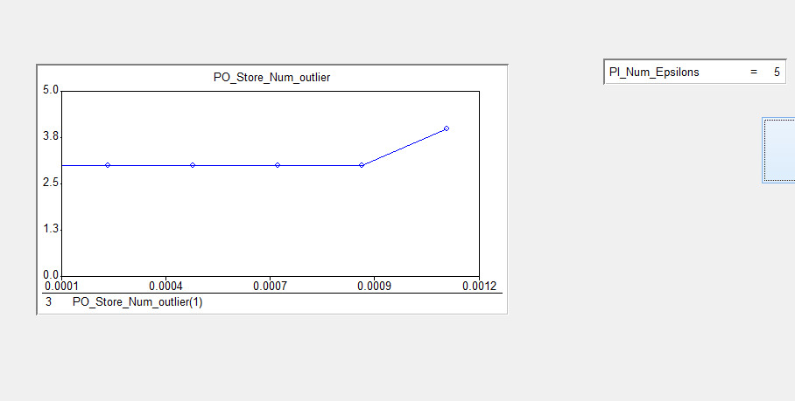
Idioms

Slide 4
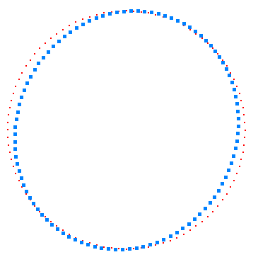
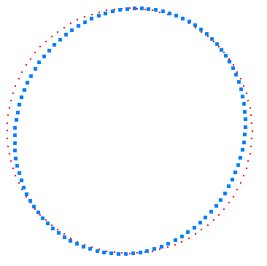
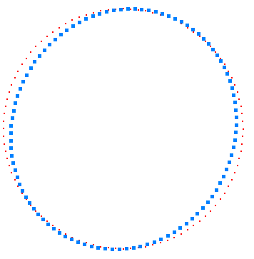
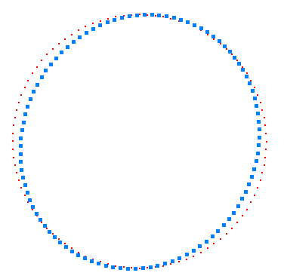
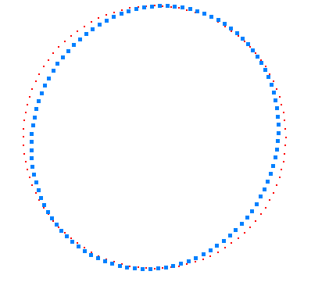
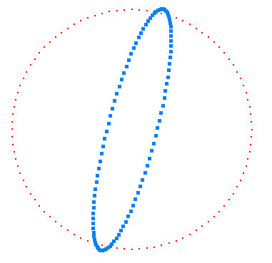
0/5 max epsilon
1/5 max epsilon
2/5 max epsilon
3/5 max epsilon
4/5 max epsilon
5/5 max epsilon
Idioms

Slide 5
Start
Iterations with putting back points
Input Data
Solve LP
Delete Outliers from data
Outliers exist?
Yes
# of Iterations<# of outliers
Yes
No
No
Compute Ri of outliers
Put a point back to data
Resolve LP
End
Is it an outlier?
Delete the point from data
Yes
No

Slide 6
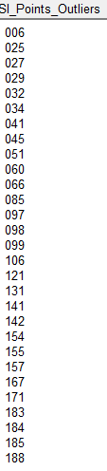
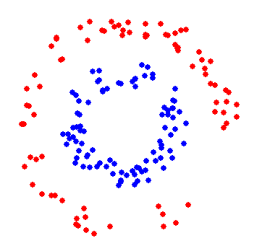
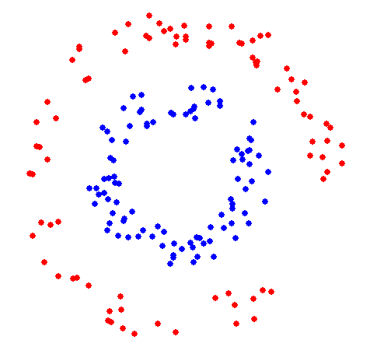
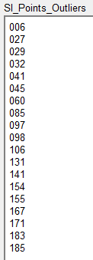
Before iterations
After 29 iterations

Slide 7
Start
Iterations with Ri
Input Data
Solve LP
Delete Outliers from data
Outliers exist?
Yes
# of Iterations<# of outliers
Yes
No
No
Compute Ri of outliers
Put point with max Ri back to data
Resolve LP
End
Is it outlier?
Delete the point from data
Yes
No

Slide 8
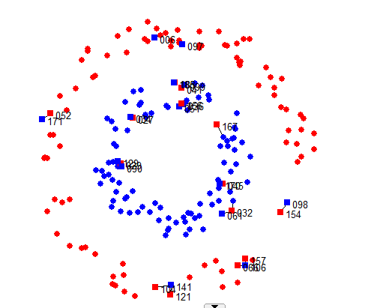
Original Data

Slide 9
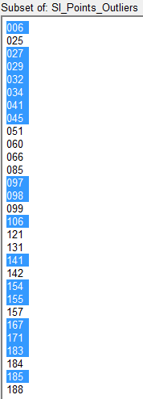
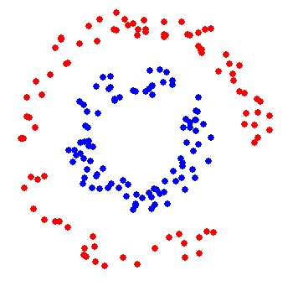
Before iterations
After 29 iterations

Slide 10
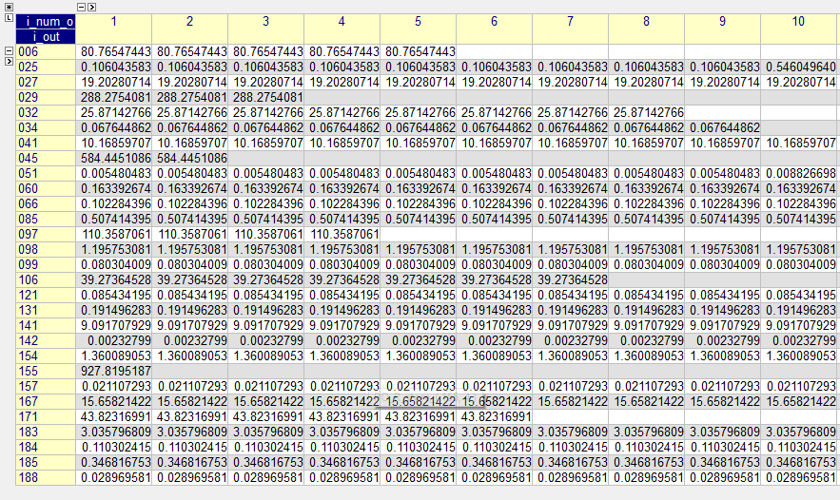
Data of Ri (with first 10 Iterations)

Slide 11
Iteration # 1 with Ri
# | Ri
155 | 927.8195
45 | 584.4451
29 | 288.2754
97 | 110.3587
6 | 80.76547
171 | 43.82317
106 | 39.27365
32 | 25.87143
27 | 19.20281
167 | 15.65821
41 | 10.1686
141 | 9.091708
183 | 3.035797
154 | 1.360089
98 | 1.195753
85 | 0.507414
185 | 0.346817
131 | 0.191496
60 | 0.163393
184 | 0.110302
25 | 0.106044
66 | 0.102284
121 | 0.085434
99 | 0.080304
34 | 0.067645
188 | 0.02897
157 | 0.021107
51 | 0.00548
142 | 0.002328

Slide 12
Iteration # 2 with Ri
# | Ri
45 | 584.4451
29 | 288.2754
97 | 110.3587
6 | 80.76547
171 | 43.82317
106 | 39.27365
32 | 25.87143
27 | 19.20281
167 | 15.65821
41 | 10.1686
141 | 9.091708
183 | 3.035797
154 | 1.360089
98 | 1.195753
85 | 0.507414
185 | 0.346817
131 | 0.191496
60 | 0.163393
184 | 0.110302
25 | 0.106044
66 | 0.102284
121 | 0.085434
99 | 0.080304
34 | 0.067645
188 | 0.02897
157 | 0.021107
51 | 0.00548
142 | 0.002328
155

Slide 13
Iteration # 3 with Ri
# | Ri
29 | 288.2754
97 | 110.3587
6 | 80.76547
171 | 43.82317
106 | 39.27365
32 | 25.87143
27 | 19.20281
167 | 15.65821
41 | 10.1686
141 | 9.091708
183 | 3.035797
154 | 1.360089
98 | 1.195753
85 | 0.507414
185 | 0.346817
131 | 0.191496
60 | 0.163393
184 | 0.110302
25 | 0.106044
66 | 0.102284
121 | 0.085434
99 | 0.080304
34 | 0.067645
188 | 0.02897
157 | 0.021107
51 | 0.00548
142 | 0.002328
45
155

Slide 14
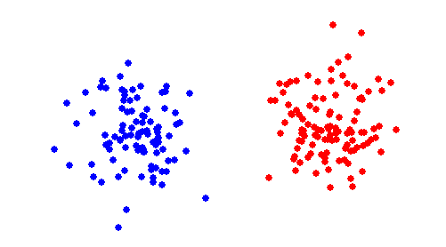
why we need to remove outliers before learning distance measure?

Slide 15
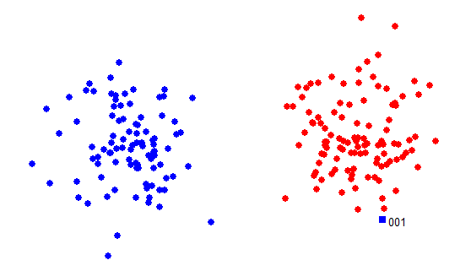
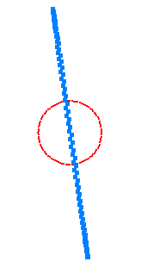
Solve Max Epsilon LP with 1 outlier

Slide 16
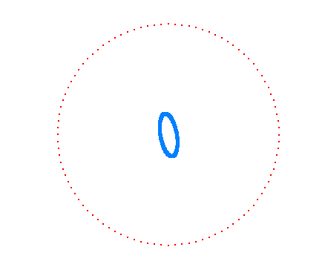
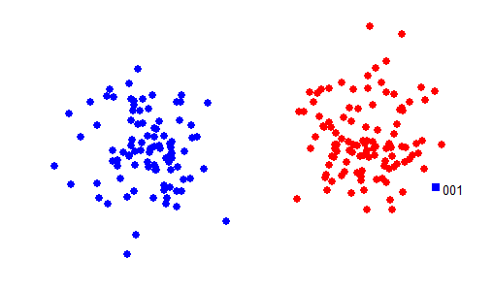
Solve Max Epsilon LP with 1 outlier

Slide 17
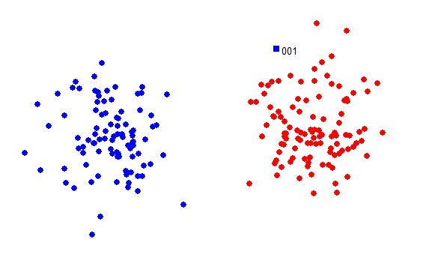
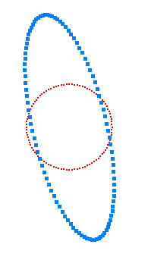
Solve Max Epsilon LP with 1 outlier

Slide 18
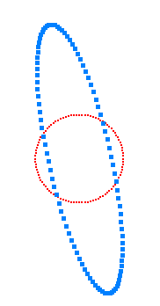
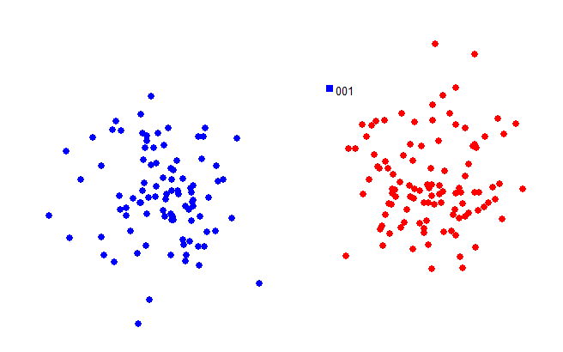
Solve Max Epsilon LP with 1 outlier

Slide 19
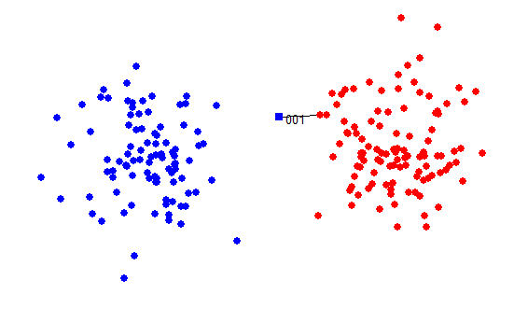
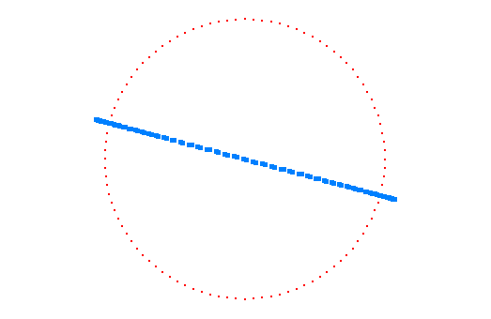
Solve Max Epsilon LP with 1 outlier

Slide 20
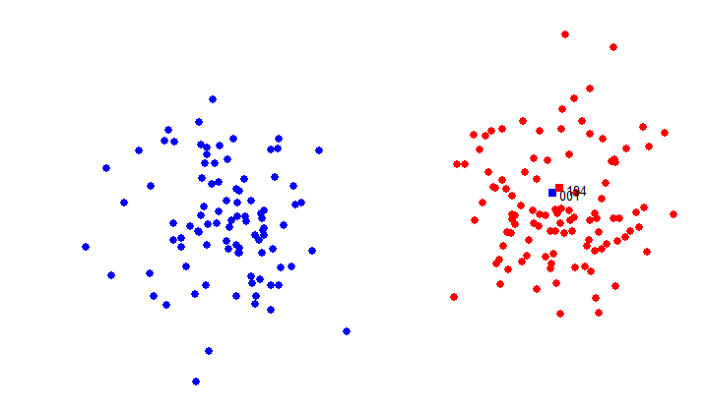
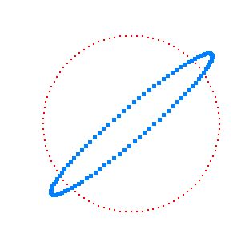
Solve Max Epsilon LP with 1 outlier

Slide 21
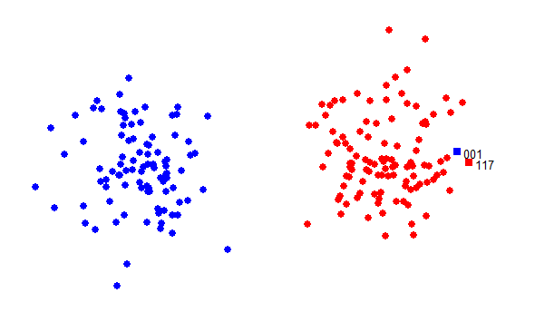
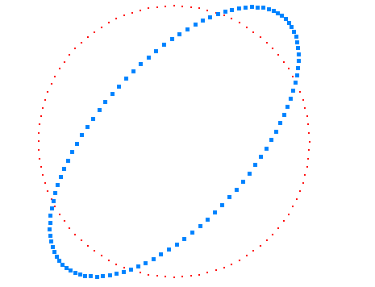
Solve Max Epsilon LP with 1 outlier

Slide 22
Thank you !

